Slide 1
CO AND PO
Team Members:
Ajith P
Karpagamainthan M
Naveen E
Guided By:
Dr Prakash S
Head of the Department,
Information Technology

Slide 2
Agenda
Abstract
Course Outcome
Program Outcome
System Requirements
Demerits of Previous
Advantages
FrontEnd & BackEnd
Future Enchancement

Slide 3
Abstract
The course outcome & program outcome attainment calculation system is a set of tools that enables the teaching staff to create student batch and enter their exam scores on the Web in order to calculate attainment.
It enables the college or university to provide individual user account to each faculty.
All the user accounts (Admin and teaching faculty) are password protected. So, the database can be termed as secured.

Slide 4
Course Outcome (CO’s)
The attainment level is calculated as follows.
80% weightage is given to the direct assessment and 20% weightage is given to the indirect assessment
In direct assessment 70% weightage is given to the end semester examination and 10% weightage is given to internal assessment.
The direct assessment formula is given as follows,
Direct Assessment=(70% of university level)+(20% of internal level)+(10 % of assignment)
The 20 % of indirect assessment is taken from the course end survey.

Slide 5
Attainment Level:
The attainment levels are set considering the average performance level.
✓Attainment Level 1: 60% students scoring more than average percentage marks in evaluative component
✓Attainment Level 2: 70 % students scoring more than average percentage marks in evaluative component
✓Attainment Level 3: 80% students scoring more than average percentage marks in university or set attainment level in final examination.

Slide 6
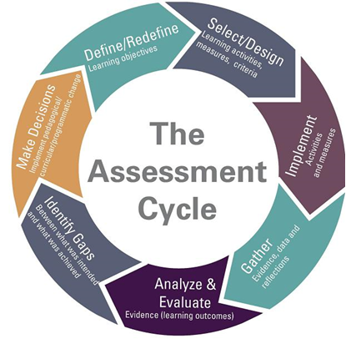
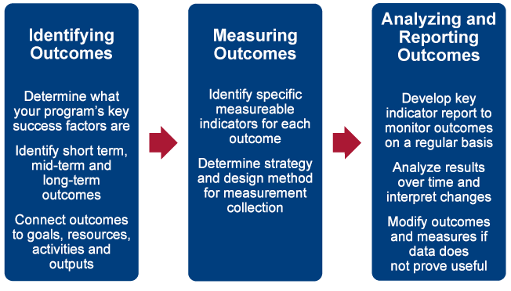
The process used to evaluate the course outcome attainment is explained in the figure below

Slide 7
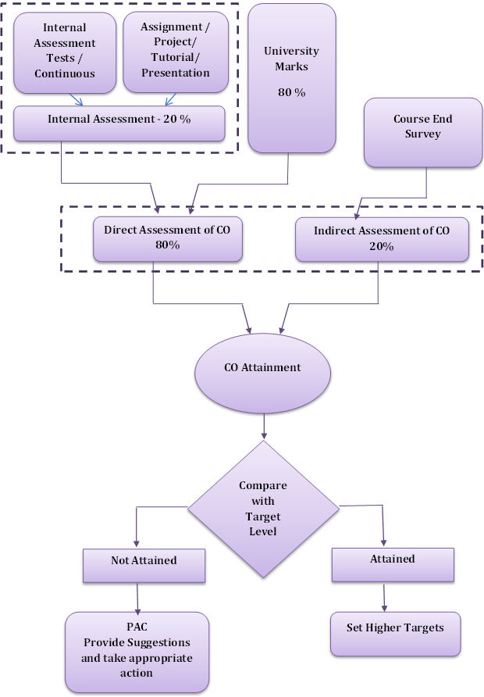

Slide 8
Program Outcome (PO’s)
DIRECT ASSESSMENT
The assessment tools are:
Internal Assessment Test
Assignments/ Group Assignments
Continuous Lab Assessment
Laboratory Internal Assessment Test
Technical Seminars
Project Assessment
Semester End Lab Examination
Semester End Theory Examination

Slide 9
INDIRECT ASSESSMENT
Program Exit Survey
The program exit survey identifies twelve broad learning outcomes related to graduate education and asks graduates to indicate the level of preparation provided by their graduate program.
This type of survey can also point to areas in which the institution should invest more or less resources to enhance a student's learning and development experience.

Slide 10
Alumni Surveys
The Alumni Survey is designed to give graduates an opportunity to reflect upon their years after graduation.
The survey includes issues relating to satisfaction regarding academic programs, intellectual and personal growth, student services, and preparation for a career.
Employer Surveys
Provide information about the curriculum, programs and course outcomes, on-the-job field-specific information about the application and value of the skills that the program offers.
It helps to determine if their graduates have the necessary job skills and if there are other skills that employers particularly value that graduates are not acquiring in the program

Slide 11
Employer survey and Student exit survey analysis is customized to an average values as per the level 1, 2, 3
PO attainment level will be 80% of direct assessment + 20% of indirect assessment in which 15% Weight-age is given to student exit survey and 5% Weight-age is given to parents survey. Similar procedure is followed for PSO.
The program assessment committee will assess the PO/PSO attainment values and will suggest appropriate actions for continuous improvement.

Slide 12
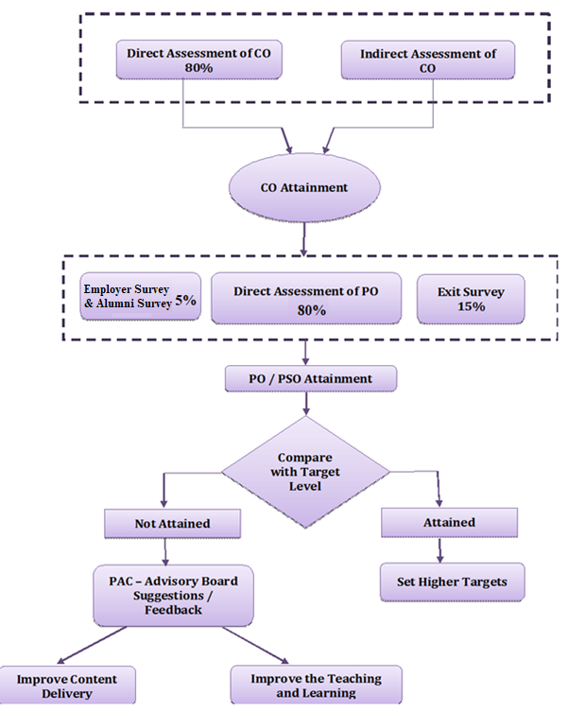

Slide 13
System Requirement
Software Requirements
Platform - Windows 10
FrontEnd - HTML,CSS,JAVASCRIPT
BackEnd - Java Servlet Page(JSP)
Hardware Requirements
Processor - Intel i5
RAM - 4GB

Slide 14
Demerits of Previous
For calculate CO and PO attainment the only choice is using spreadsheets.
In that the faculty have to use some critical formulas to calculate the attainment.Not all the people expert in using Spreadsheets.
The spreadsheets kept by the corresponding faulties in their local PC. So it is not accessable by the HoD or faculties.
Need to create separate Google forms to take surveys

Slide 15
Advantages
One single online platform to maintain all students marks and thier attainment
Since all the mark details and po mapping are available in the portal,no need to share the marksheets individual faculties
Student and parents can able to submit their survey details at anytime
Since it is a portal all the data is stored in Database not in some ones PC
HoD and Principal can able to inspect the students marks and faculty's attainment progress at any time

Slide 16
FrontEnd
HTML - It is a framework Which gives Structure to web page.
CSS - It is used to make webpage more attractive.
JAVASCRIPT - It is used to control the behaviour of web page.
BackEnd
JSP - It is a server side programming thechnology that enables the creation of dynamic platform independent to developing web applications.

Slide 17
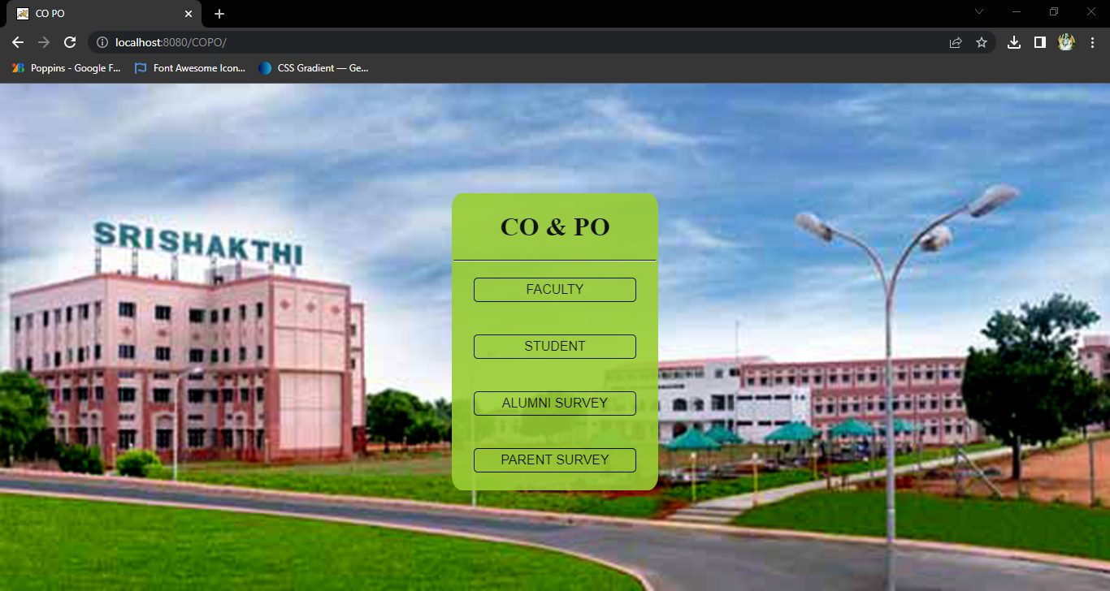
HOME PAGE

Slide 18

DEPARTMENT PAGE

Slide 19
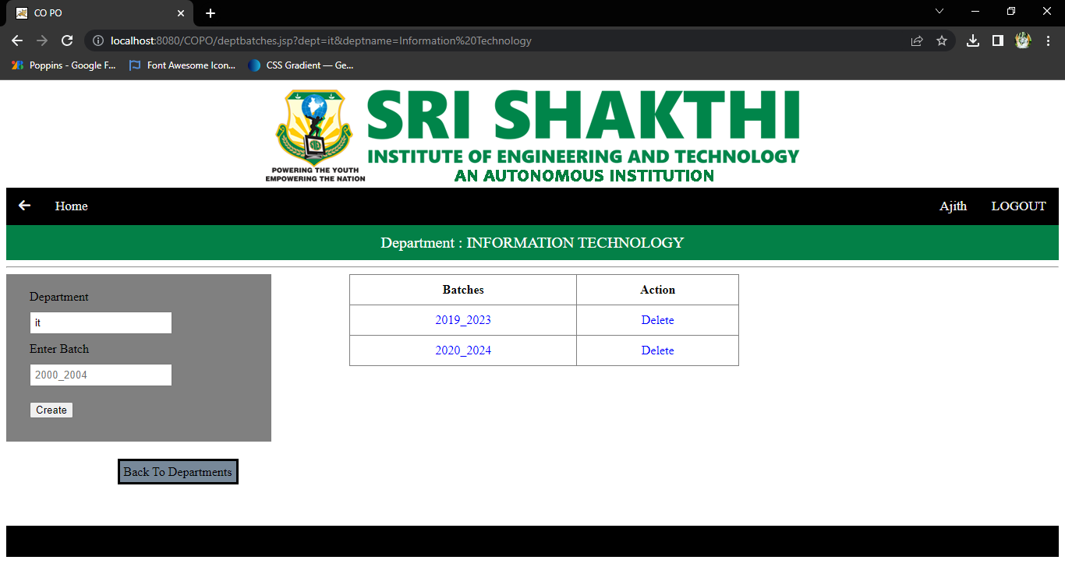
CREATE BATCH

Slide 20
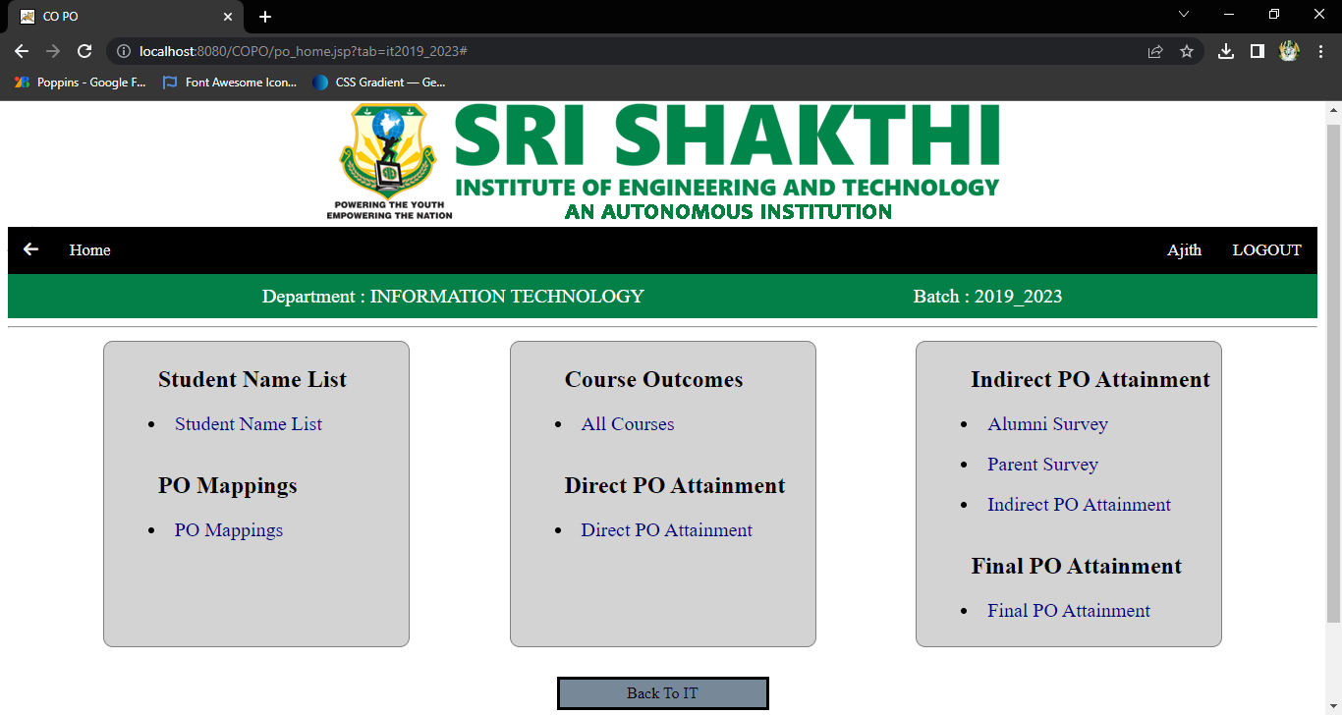
PO HOME PAGE

Slide 21
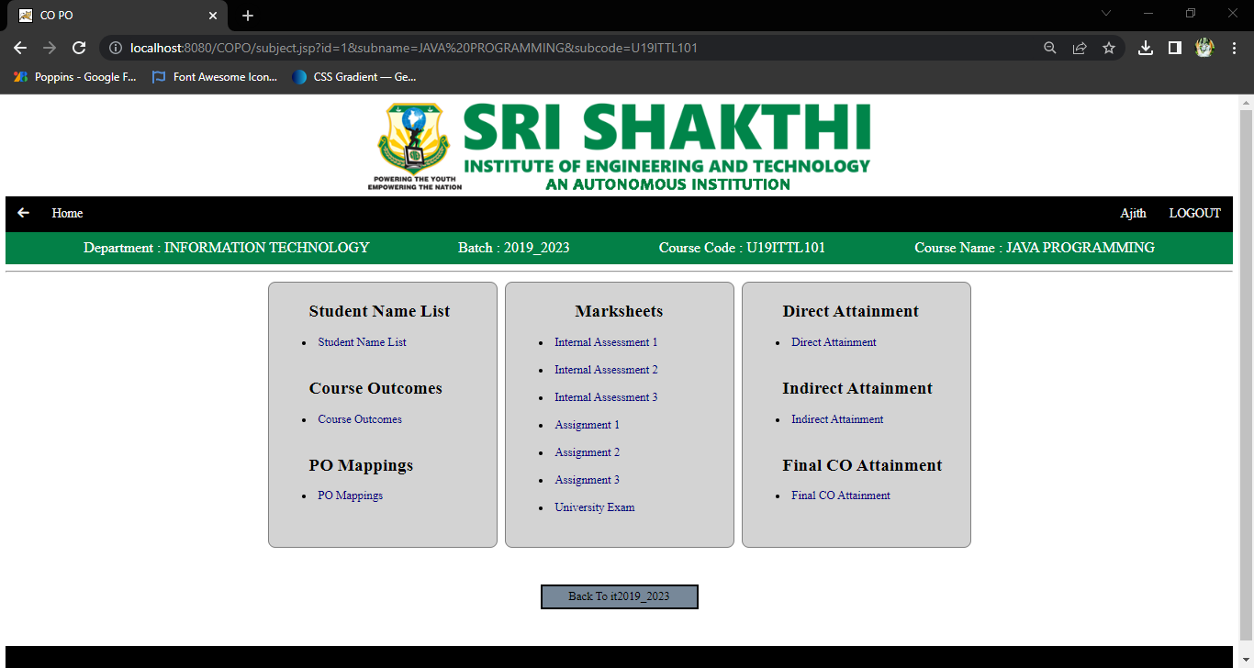
SUBJECT PAGE

Slide 22
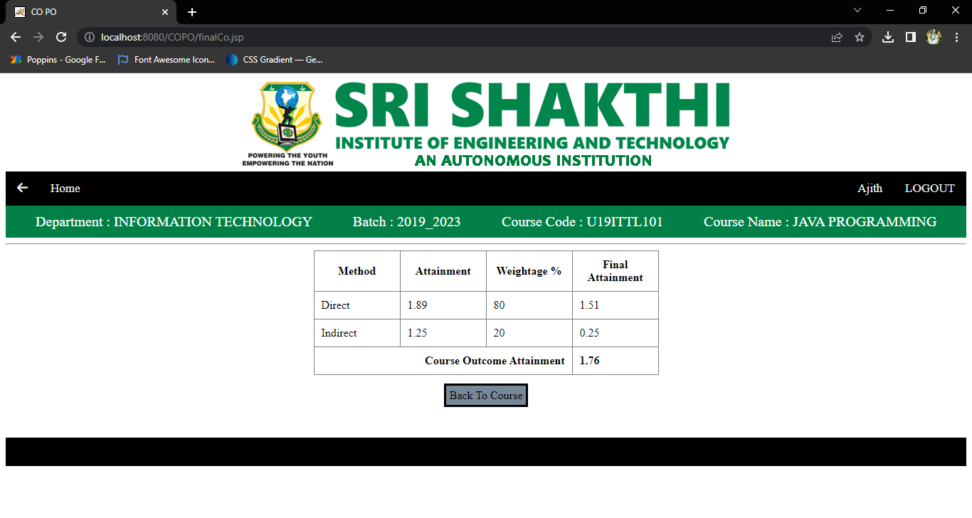
FINAL CO PAGE

Slide 23
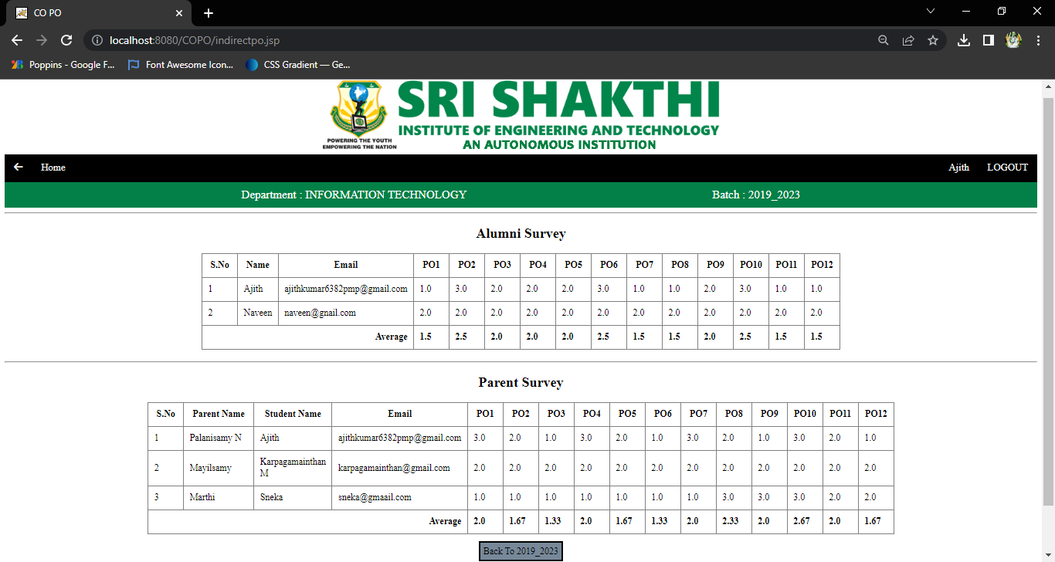
INDIRECT PO PAGE

Slide 24
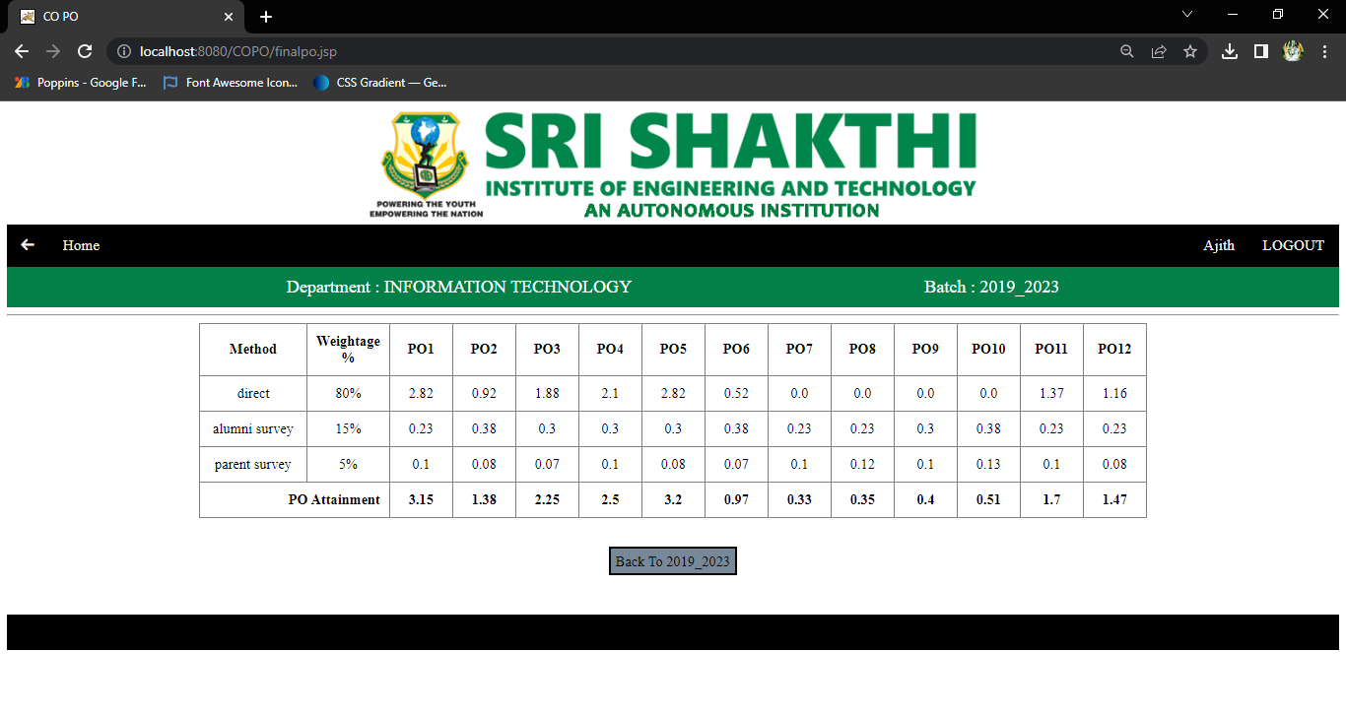
FINAL PO PAGE

Slide 25
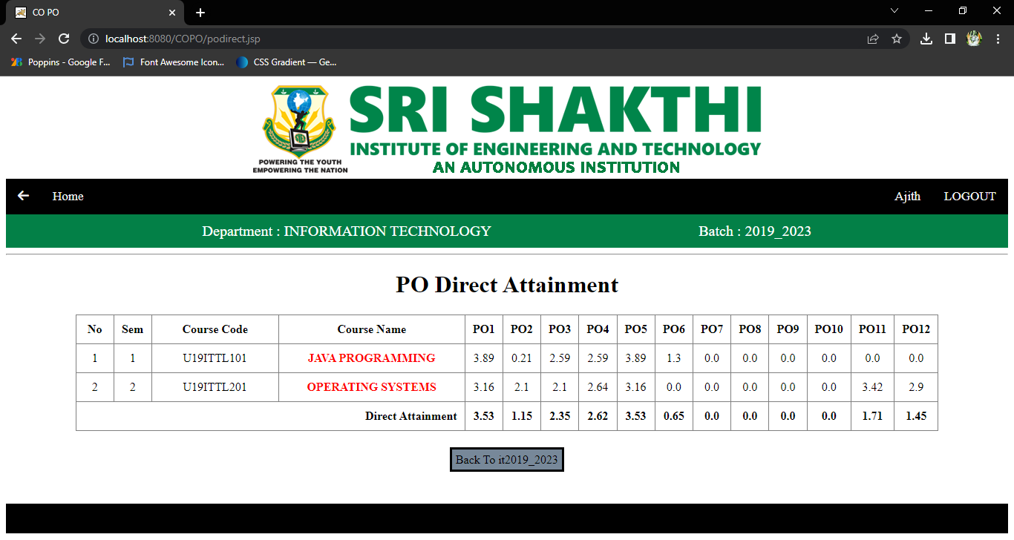
DIRECT PO PAGE

Slide 26
Future Enchancement
•To implement a feature for the faculty to view only his/her c respective subjects alone..
•Feature to take print out of final attainment result.
•Updating features for the existing batch.

Slide 27
THANK YOU

